Slide 1
Center for Advanced Energy Studies
MicroEC Research Update
06.30.25
Gabriel Lewis
Dr. Haiyan Zhao
A research partnership between Boise State University, Idaho National Laboratory, Idaho State University and University of Idaho.
Notes:
Good Afternoon,
It's great to see you all again. Today, I will go over our update with our MicroElectrochemistry research. I'll be talking about our redox potential measurements in the past, our newest electrode configuration, and recent redox potential measurements using said electrode configuration.

Slide 2
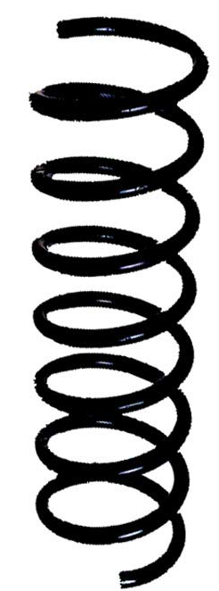
K+/K Redox Potentials at 650°C in FLiNaK salt using Ni electrodes
Measurements taken with 4 different configurations over the 4 salt weights
The average redox potential for this set is –1.623V ± 261mV
Scan Rate | 40g | 10g | 1.0g | 0.1g
50mV/s | -1.529V | -1.483V | -1.998V | -1.649V
100mV/s | -1.399V | -1.524V | -1.999V | -1.694V
200mV/s | -1.279V | -1.358V | -1.967V | -----
14mm
0.5mm
0.25mm
Thermocouple
10mm
10mm
3mm
6mm
1.5mm
3mm
RE CE WE
RE CE WE
RE CE WE
RE CE WE
Notes:
For 650 degrees, measurements were taken with 4 unique configurations for each FLiNaK salt mass with different surface areas. Among 40, 10, 1, and 0.1g salt with 50, 100, and 200mV/s salt scanning rates, the average redox potential for this table is –1.623V with a deviation of 261mV. Wires in black represent a diameter of 0.5mm and blue 0.25mm

Slide 3
K+/K Redox Potentials at 600°C in FLiNaK salt using Ni electrodes
The average redox potential for 600°C from this table is –1.632V ± 200mV
A combination of factors (scan rate, salt weight, electrode surface area, and temperature) are driving the variance in the measured redox couple for K+/K
 | 40g | 10g | 1.0g | 0.1g
50mV/s | -1.797V | -1.747V | -1.317V | -1.663V
100mV/s | -1.851V | -1.794V | -1.334V | -1.648V
200mV/s | -1.792V | -1.709V | -1.344V | -1.693V
It is worth investigating this trend of redox potentials using the same type of electrode configuration
Notes:
For 650 degrees, the average redox potential for this data set is –1.623V with a deviation of 200mV, using the same electrode configurations as in the previous slide. From the data, we can ascertain a number of factors that include scanning rate, salt mass, electrode configuration, and temperature that influence the range of values for the redox potential for the K+/K couple.
In order to reduce this variance, it is worth control for the electrode configuration, and use the same immersion depth for all four salt masses.

Slide 4
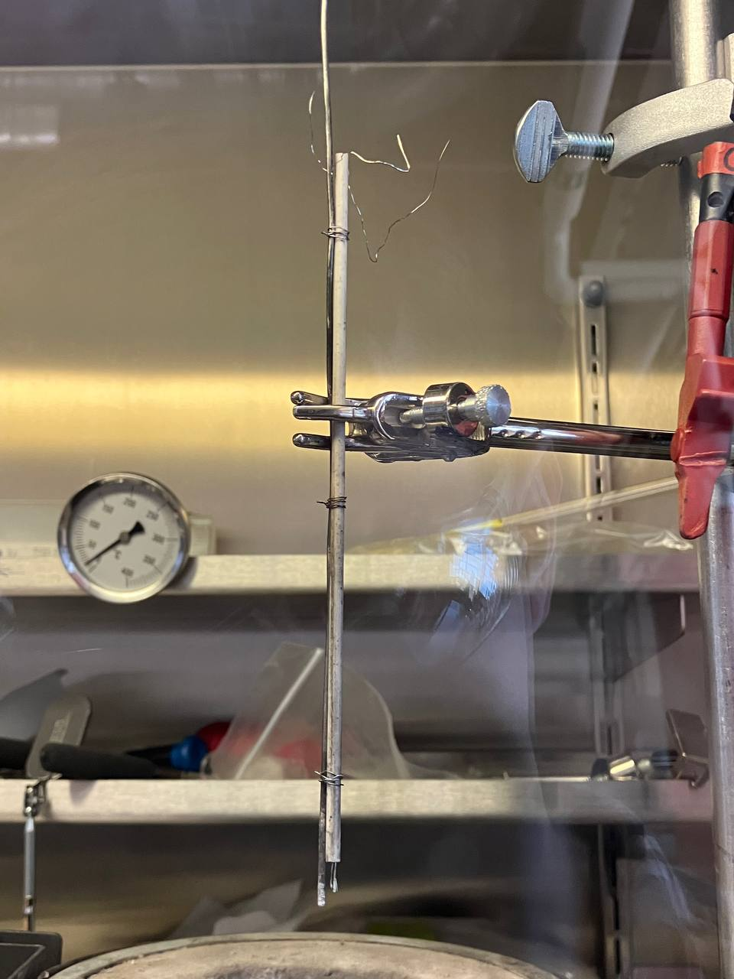




Integrated Electrode Bundle for all Salt Weights
3mm diameter four-bore Alumina tube bound with thermocouple
Nickel RE/WE Immersion Depth: 1.5mm
Nickel CE Immersion depth: 2.0mm
Same immersion depth for all salt weights 0.1g - 40.0g
166mm
2.0mm
1.5mm
0.5mm
0.25mm
Thermocouple
Electrode Port Diameter: 0.75mm
RE CE WE
Notes:
Depicted in this slide is our 'Integrated Electrode Bundle for all the salt weights, in which we use a 3mm diameter electrode bearing-Alumina tube that carries two 0.25mm diameter Ni wires and one 0.5mm diameter Ni wire for the Reference, working, and counter electrodes, respectively. We use the thermocouple as an anchor to make contact with the bottom of the crucible, to adjust for different salt heights of each salt mass.

Slide 5
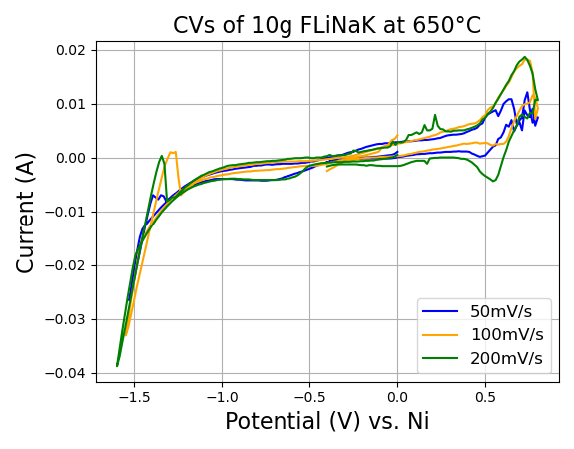
K⁺/K Redox Reduction Curve - 10 g at 650°C
K+/K reaction curve:
50mV/s: -1.416V
100mV/s: -1.346V
200mV/s: -1.382V
Notes:
In using the uniform configuration of the electrodes, I've measured 10g of salt at 650 degrees C and found the redox potentials of –1.416 for 50mV/s, -1.346V for 100mV/s, and –1.382V for 200mV/s.

Slide 6
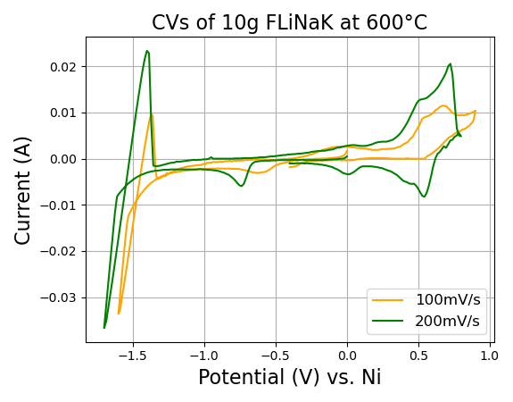
K⁺/K Redox Reduction Curve - 10 g at 600°C
K+/K reaction curve:
100mV/s: -1.454V
200mV/s: -1.503V
Notes:
For 600 degrees C, the redox potentials of 100mV/s and 200mV/s are –1.454 and –1.503V, respectively. Measurements on this day scanning for 50mV/s were attempted, but did not succeed reversing direction past –1.6V.

Slide 7
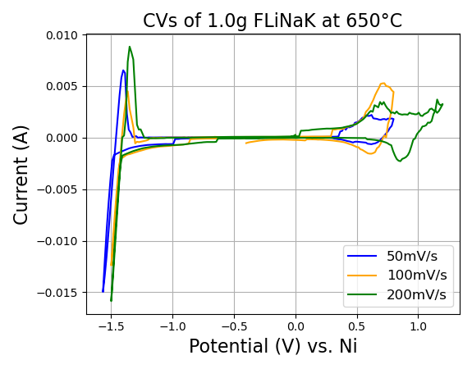
K⁺/K Redox Reduction Curve - 1.0 g at 650°C
K+/K reaction curve:
50mV/s: -1.437V
100mV/s: -1.395V
200mV/s: -1.376V
Notes:
Scaling down to 1.0g of FLiNaK salt, the cyclic voltammogram taken at 650 degrees C yields –1.437V for 50mV/s, -1.395V for 100mV/s, and –1.376V for 200mV/s.

Slide 8
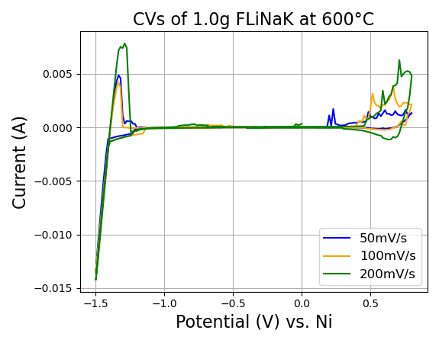
K⁺/K Redox Reduction Curve - 1.0 g at 600°C
K+/K reaction curve:
50mV/s: -1.362V
100mV/s: -1.356V
200mV/s: -1.355V
Notes:
Taken on the same day, CVs at 600 degrees celcisus yieled redox potentials for the potassium curve with ////

Slide 9
K+/K Redox Potentials at 650°C in FLiNaK salt using Uniform Integrated Electrode Bundle
Redox potentials for 10g and 1.0g FLiNaK salt fall between –1.44V to -1.375V, with an average of –1.392V ± 30mV
With the uniform integrated bundle, the variance of redox potentials has been reduced.
 | 40g | 10g | 1.0g | 0.1g
50mV/s | ---- | -1.416 | -1.437V | ----
100mV/s | ----- | -1.346V | -1.395V | ----
200mV/s | ------ | -1.382V | -1.376V | ----
Literature^{1,2} | Vs. Pt | 30g
100mV/s |  | -1.272V
¹Guo, S. et al. (2017). Journal of Nuclear Materials, 496(C), 197-206.
²Chesser, R. et al. (2018). Annals of Nuclear Energy, 120(C), 246-252.

Slide 10
K+/K Redox Potentials at 600°C in FLiNaK salt using Uniform Integrated Electrode Bundle
Redox potentials for 10g and 1.0g FLiNaK salt fall between –1.503V to -1.355V, with an average of –1.406V ± 70mV
 | 40g | 10g | 1.0g | 0.1g
50mV/s | ---- | ---- | -1.362V | -----
100mV/s | ----- | -1.454V | -1.356V | ----
200mV/s | ------ | -1.503V | -1.355V | -----

Slide 11
Next Steps
Collect cyclic voltammogram using uniform integrated electrode bundle in 40.0g and 0.1g FLiNaK salt at 600°C and 650°C, using scan rates of 50, 100, and 200mV/s.
Deduct how redox potentials/CVs change with different masses
Redo measurements for 10.0g
Stage testing environment for 0.1g + 5wt% UF₄ cyclic voltammetry measurements

Slide 12

Questions & Discussion
Works Cited
Guo, S., Shay, N., Wang, Y., & Zhang, J. (2017). Measurement of europium (III)/europium (II) couple in fluoride molten salt for redox control in a molten salt reactor concept. Journal of Nuclear Materials, 496(C), 197-206. https://doi.org/10.1016/j.jnucmat.2017.09.027
Chesser, R., Guo, S., Zhang, J. (2018). Electrochemical behavior of dysprosium and lanthanum in molten LiF-NaF-KF (Flinak) salt. Annals of Nuclear Energy, 120(C), 246-252. https://doi.org/10.1016/j.anucene.2018.05.045
Notes:
Redox potentials are varied by decreasing concentrations of salt and temperature

